Slide 1
Customisation Process for Distributed Software Development projects
Abdulrahman Qahtani
Supervisors
Gary Wills and Andy Gravell

Slide 2
Research Domain
Distributed Software development
Prikladnicki, Audy, & Evaristo (2003) defined distributed software development as
“a software development process where at least one involved actors (project team, customer or user is physically distant from the other”

Slide 3
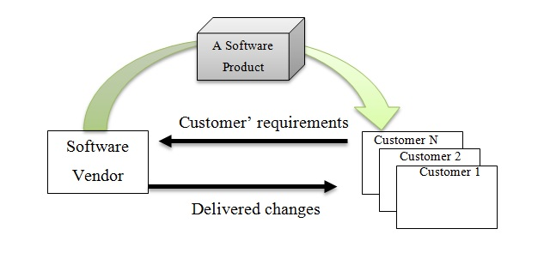
Research Domain
Customisation process

Slide 4
Problem Statement
Customer’s location
Central development centre
Customisation requests
Representative
Decision making
Customer
Queries, documents…etc.
Working software
Development team
Making a decision and development of customers’ requirements by a distributed team increase the communication challenges.
Its implications are delays in:
* Decision making
* Development process
* Entire customisation process

Slide 5
The Proposed Solution
Customer’s location
Central development centre
Decision making
For customisation req.
Customisation requests
Decision making
Customer
Local
Customisation team
Development
Working software

Slide 6
Evaluation Process
Contextual inquiry
Conducting the contextual inquiry on a real world case, a company customise software for 18 distributed customers.
Study out put:
1- A conceptual model of a current model of real case
2- A historical data which used as a trace data to drive the simulation process.
I_{S}
I_{M}

Slide 7
Evaluation Process
Simulation Method
Run the data on a simulation for the Real case model
OS: output of the Simulation model
I_{S}
Trace data from the real case
Run the data on a simulation for the introduced model
OM: output of the introduced model
I_{M}

Slide 8
Evaluation Process
Confirmatory Study
Conducting semi structured interviews with 7 experts in the company to show them the simulation output and take their feedback.

Slide 9
The Project Journey
Literature review
Framework of challenges in DSD with experts review
Contextual inquiry study
A model for local decision making in customisation process for DSD projects.
Evaluation using simulation method Simulation
Confirmatory study

